Slide 2
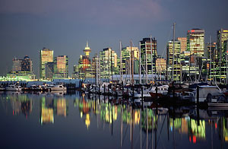
Considering the global dimensions of transportation infrastructure investment in Canada’s three largest cities
Anthony Perl
aperl@sfu.ca

Slide 3
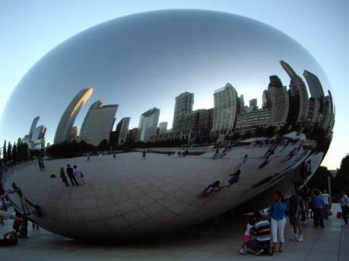
Canadian urban infrastructure policy reflects three characteristics worth exploring
Global city dynamics at critical junctures in policy development
Policy path dependence and the increasing costs of policy change
Equivocation as a policy strategy yields particular infrastructure challenges

Slide 4
A structural attribute of Canadian infrastructure development has been the predominant absence of urban policy at the national level
Ottawa has had limited engagement in urban and regional planning
Canada only once pursued a nationally sanctioned highway program of the scale that could reshape an urban core
CITIES

Slide 5
Canada’s 3 largest cities move differently from each other
Infrastructure disparities both reflect diverse urban mobilities and embed these differences in the urban fabric

Slide 6
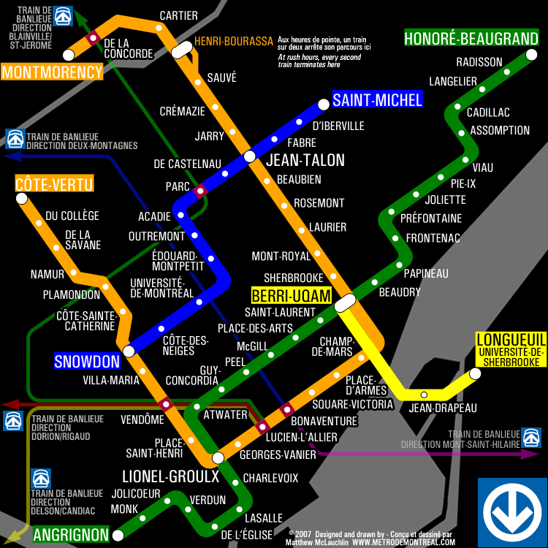
Montreal has Canada’s most extensive urban highway and transit infrastructure
1.9 / 4.1 million population in the city/region as of 2014
Metro opened in 1966
68 stations
69.2 km route length

Slide 7
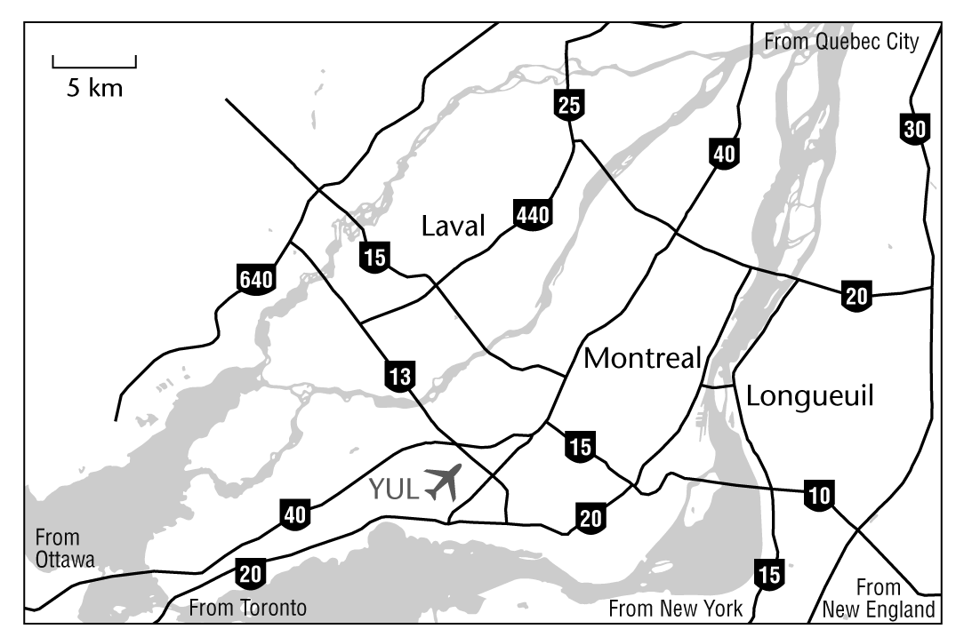
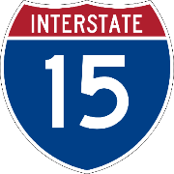
Montreal’s expressway network most resembles the U.S. Interstate pattern of complete urban coverage

Slide 8
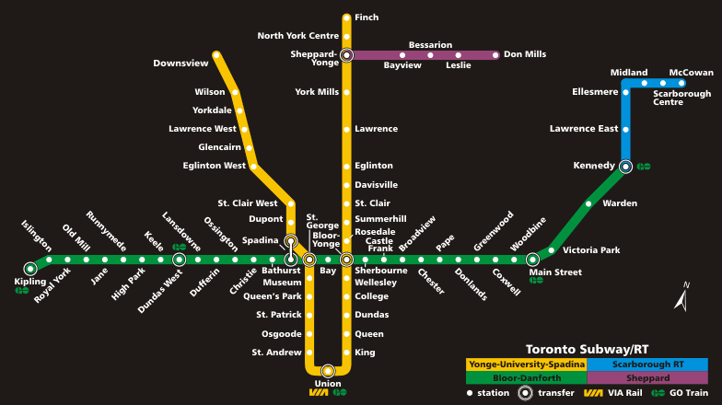
Toronto has an under-sized rapid
transit network for a city of 2.6 million
and a metro region of 6 million
Subway opened in 1954
69 stations
68.3 km

Slide 9
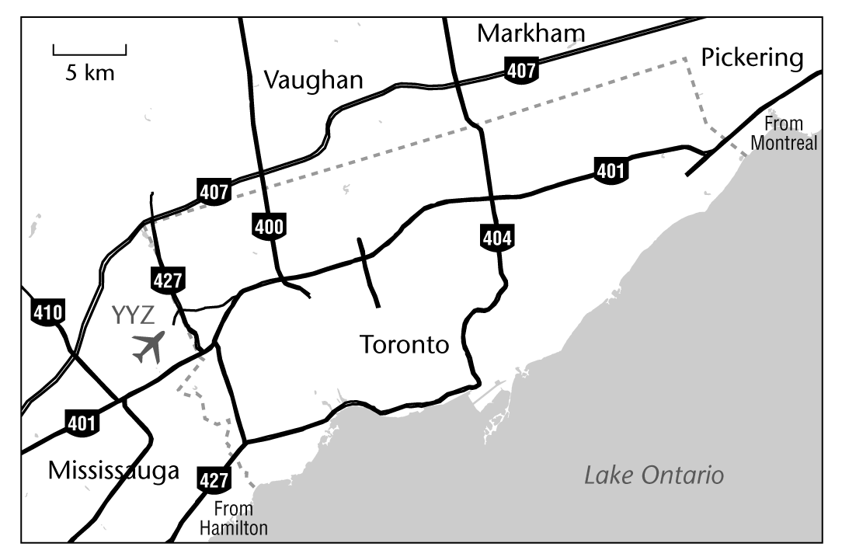
Toronto is surrounded by expressways
with limited passage through
the urban core

Slide 10
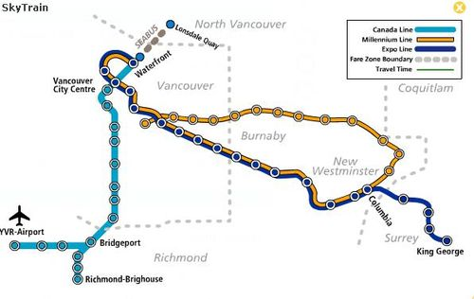
Vancouver has been building one rapid transit line per decade since the 1980s
600,000 population in the city
2.4 million in the region
47 stations
68.7 km of routes

Slide 11
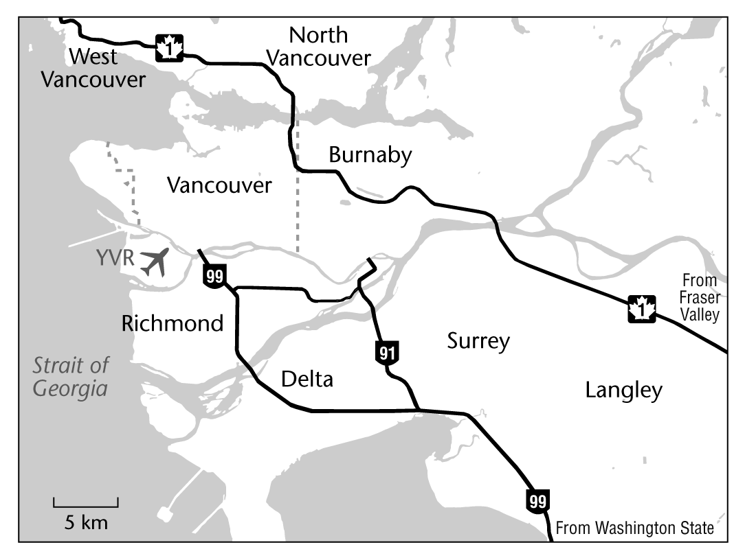
Expressways bypass the city of Vancouver almost entirely

Slide 12
How did Montreal, Toronto and Vancouver reach such different relationship between highway and rapid transit infrastructure?
Global city dynamics were less constrained by national and provincial policies, offering an opportunity for the global to influence the local more directly and more dynamically

Slide 13
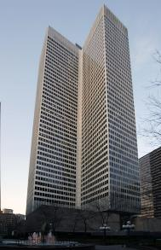
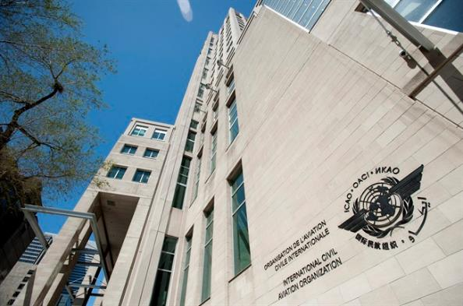
In 1960s, Montreal was the ‘Alpha’ in Canada’s global city hierarchy
Canada’s financial centre
Most corporate headquarters
ICAO, Canada’s only UN agency
IATA’s North American headquarters

Slide 14
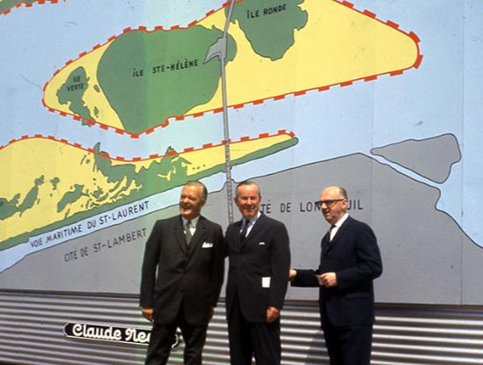
Global status motivated successful competition for mega-events to leverage senior government’s investment in infrastructure

Slide 15
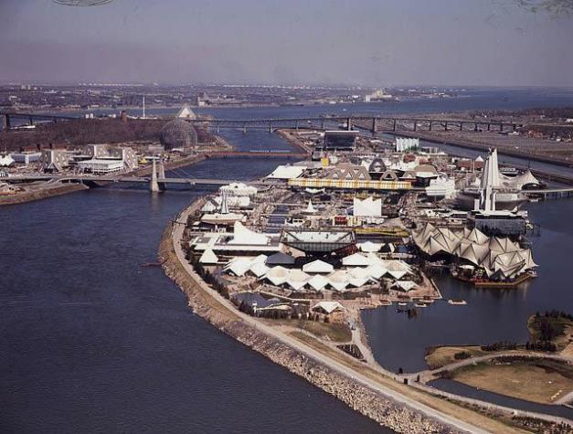
Federal and provincial governments invested in expressway and metro projects that had to be ready by 1967
Linkage between an infrastructure mega-project(s) and mega-event reduced the uncertainty about arrival of benefits.

Slide 16
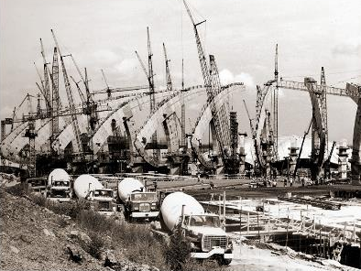
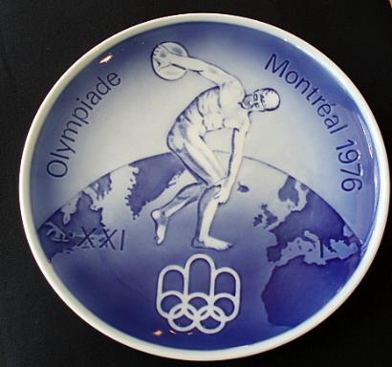
Montreal extracted an even bigger Olympic commitment from federal and provincial governments based on Expo’s success
Montreal offers Canada’s only example of a locally formulated national urban policy

Slide 17
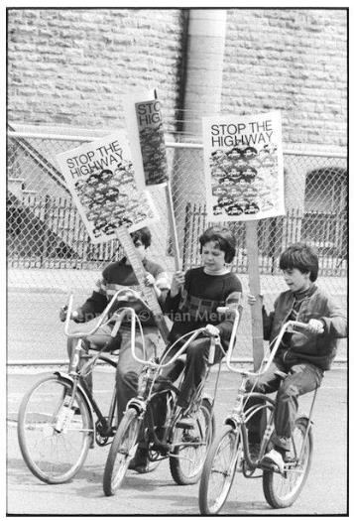
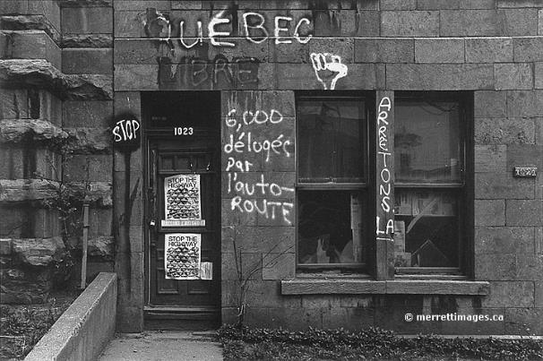
Neighbourhood destruction linked Montreal’s anglos and francophones in resistance against urban expressways

Slide 18
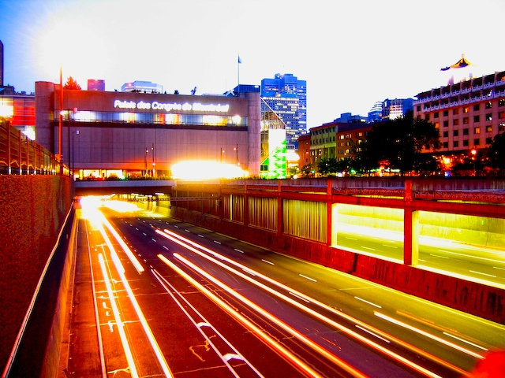
Global commitment trumped local concern when it came to completing Montreal’s expressway network

Slide 19
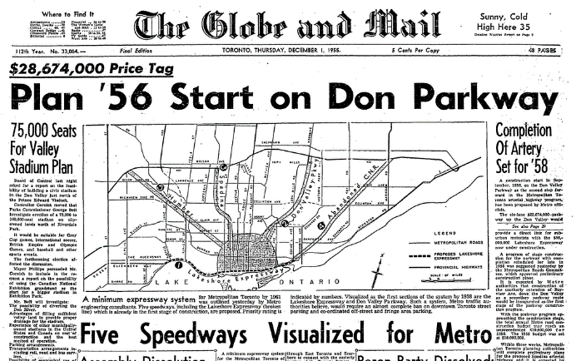
Ontario’s highway development was led provincially, focusing on provincial, more than urban, economic development

Slide 20
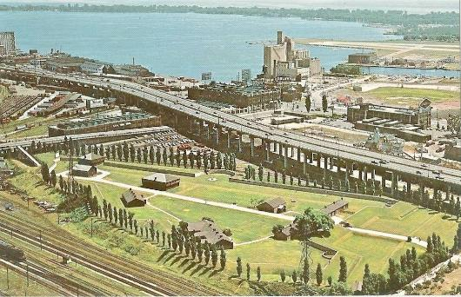
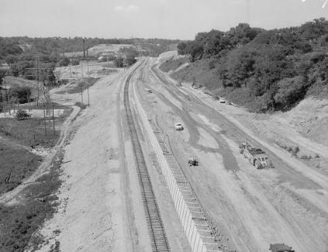
Toronto’s first expressways fed Provincial Highways and were routed through undeveloped or industrial land

Slide 21
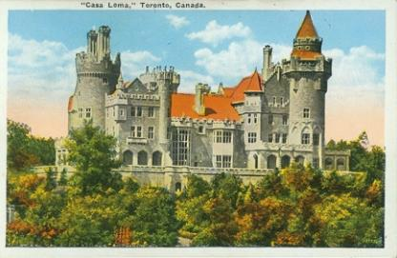
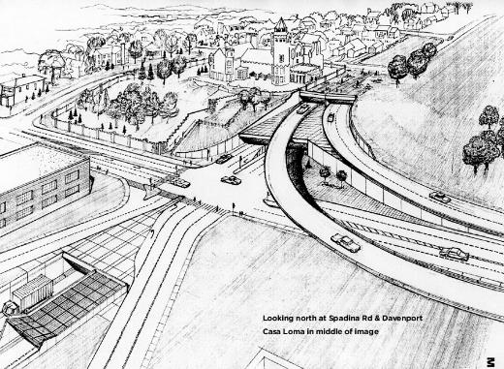
A complete urban expressway network would have required disrupting established communities

Slide 22
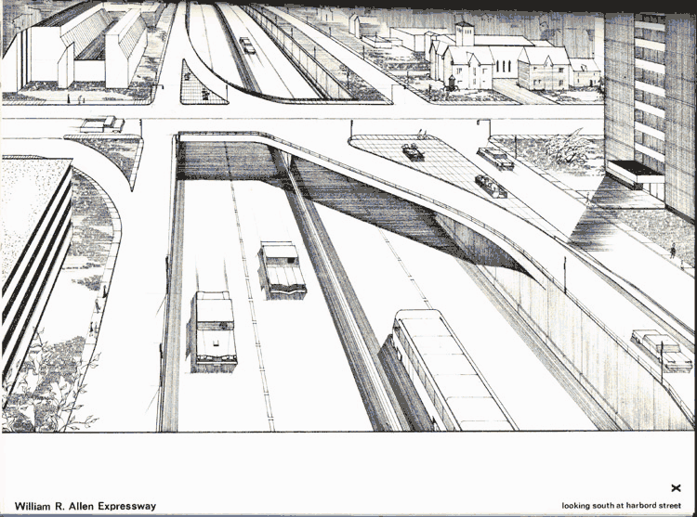
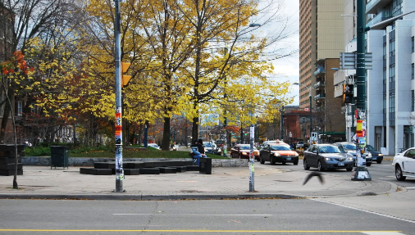
Spadina Expressway plan would sever University of Toronto campus from neighbourhoods to the west

Slide 23
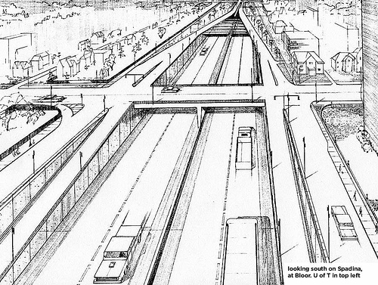
A four lane divided highway trench was proposed to run south of Bloor St. to Lakeshore Blvd.

Slide 24
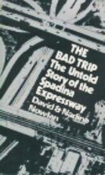
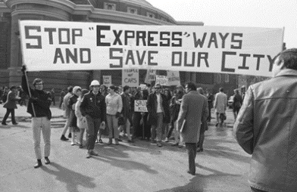
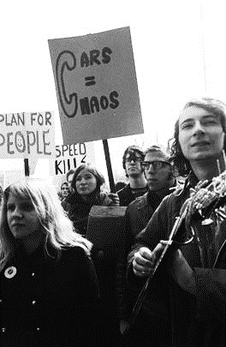
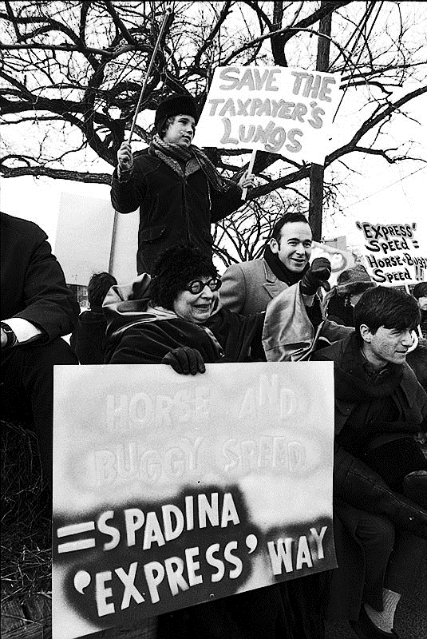
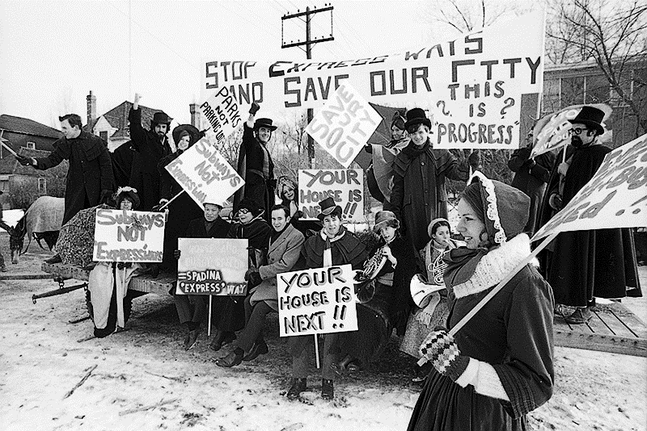
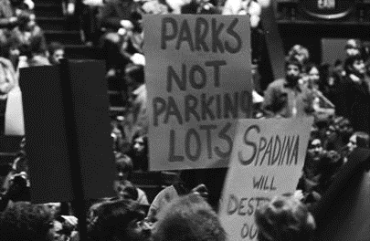
Both material and post-material values motivated protests to ‘Stop Spadina’

Slide 25
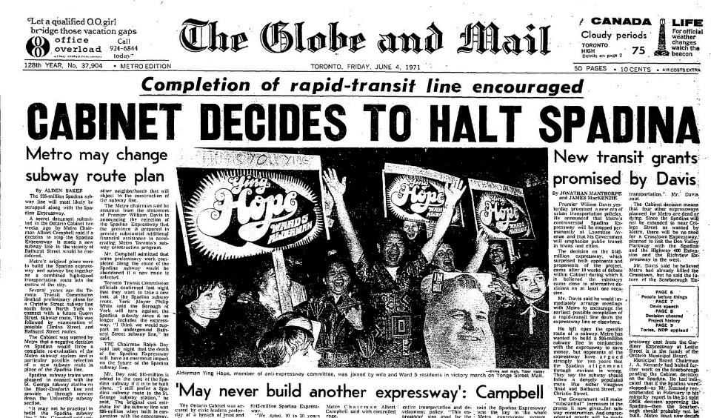
Delays sent Spadina Expressway over budget, setting up a critical juncture

Slide 26
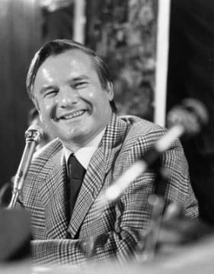
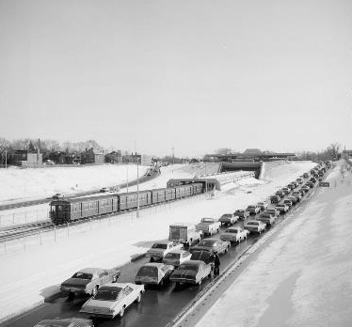
Ontario’s Premier replaced unfinished portion of the Spadina expressway with rapid transit
“If we are building a transportation system to serve the automobile, the Spadina Expressway would be a good place to start. But if we are building a transportation system to serve people, the Spadina Expressway is a good place to stop.”

Slide 27
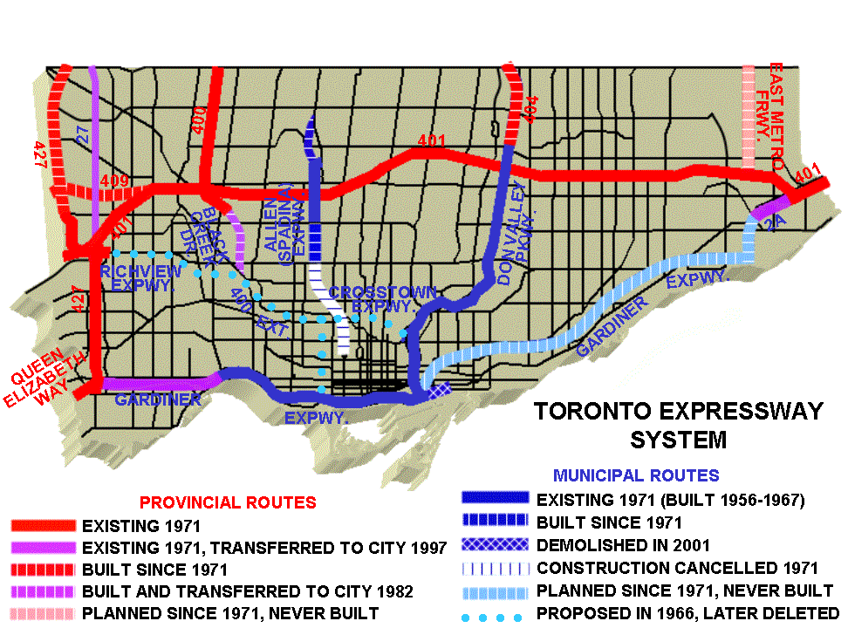
Ontario has stopped more expressway plans than any other Canadian province – most of them passing through Toronto

Slide 28
Highways and suburban development grew far and fast outside the city of Toronto, inspiring the metaphor of Vienna surrounded by Phoenix

Slide 29
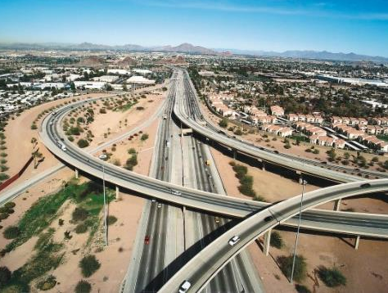
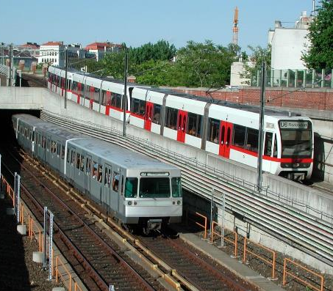
What infrastructure would be required to effectively meet the mobility needs of both Phoenix and Vienna?
A supply-side solution to the GTA’s mobility dilemma
would be extremely costly

Slide 30
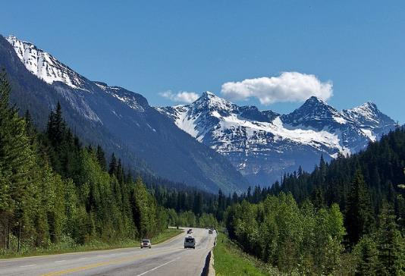
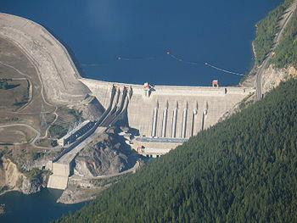
In the 20th century, British Columbia focused most infrastructure spending outside cities

Slide 31
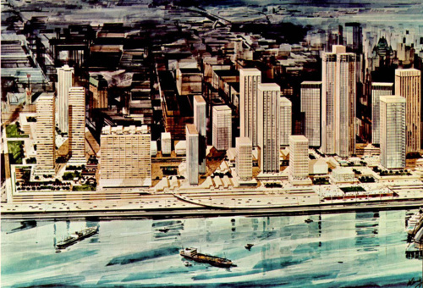
But there were urban redevelopment schemes in mind for Vancouver’s waterfront …

Slide 32
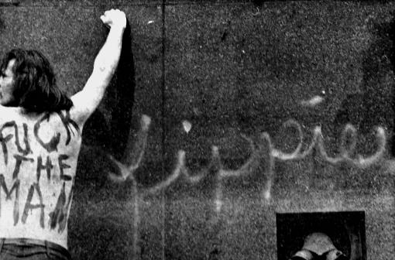
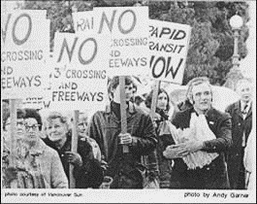
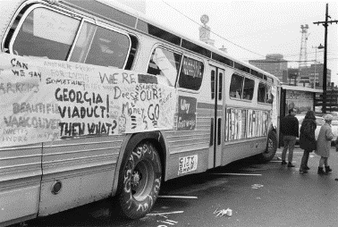
Activists mounted spirited and unconventional protests

Slide 33
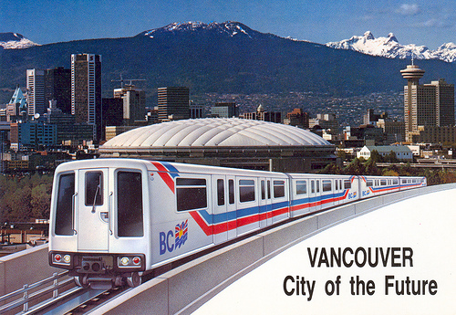
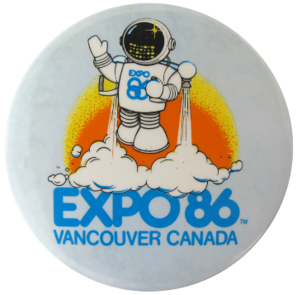
Without federal or provincial funding, Vancouver abandoned its urban expressway plan and came to pursue a different global growth strategy

Slide 34
Core expressway length differences reveal three global city mobility trajectories
Modern
Equivocal
Post-Mod

Slide 35
Implications for urban transportation infrastructure policies across Canada
Global city dynamics can catalyse public and private investment in urban transport infrastructure.
Firm deadlines for infrastructure delivery, like a mega-event, can increase public support for mega-projects.
Equivocation can be a politically expedient policy strategy, but it defers increasing economic costs that cannot be avoided forever.

Slide 37
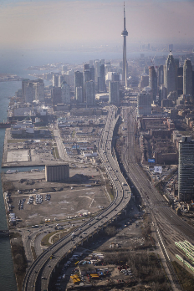
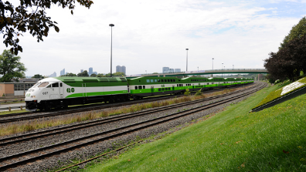
The State of Evidence Based Transportation Policy in Toronto
Matti Siemiatycki Geography and Planning University of Toronto
Notes:
In this presentation I would like to look at the ways that evidence is created and used to support specific infrastructure projects.
Discuss mega-project paradox – Flyvbjerg
By integrating both tangible and intangible variables into the conscious construction of image, it will be shown that the promotion of public transit merges function with form, becoming the intersection of mass mobility and mass/popular culture.
It is this broad appeal, and more specifically the conceptualization of the Delhi Metro as a vehicle for societal transformation, that has led to the widespread support for the project.
1) I’m going to begin by talking about three cases from Canada where evidence was used in diverse ways to support varied decisions
2) Once I’ve provided you with a few examples, I’ll explain how I think technical evidence coexists alongside more symbolic, non-quantifiable factors in influencing which projects get built and when
3) I’ll reflect on what this means for decision making

Slide 38
Standard Policy Development Cycle
Metrolinx Business Case Process
Emergence
of a problem
Identification as a
public problem
Agenda Setting
Formulation
Of
Alternatives
Selection of
Alternative
Implementation
of Plan
Evaluation
Howlett, 2009
Notes:
Show three examples: the decision making process deviated so far from the standard policy development process that it was almost unrecognizable.
Indeed, in many ways, there was no attempt to even undertake such an analysis.
Not only did politics appear to play a very significant role in each case, but the types of arguments being marshaled had no basis in what we might call technical evidence
If anything, they drew on evidence about the tangible benefits of the project or policy, and blended them with an intangible, difficult to quantify set of meanings about why the project was important
Rather they drew on all sorts of symbolic factors that had little to do with the technical evidence
So we would be hard pressed to understand these decisions through the lens of the standard policy development cycle

Slide 39
How is Evidence Used in Toronto? Case 1 – Finch LRT
Finch LRT Business Case, Steer Davies Gleave, 2015
“The project cost is estimated at $551m, including the 14 vehicles required to operate the route.”
“The resulting 2031 forecast shows some 3,600 riders on the extension in the morning peak period, or some 1,600 in the peak hour. Line flow peaks at around 900/hour, below the typical demand considered appropriate for LRT. Transfer from car is accounts for 22% of the LRT demand.” p. i
“The resulting evaluation is presented in the table below. Monetised transportation user benefits total $546m, with additional transit user benefits expected through the improved reliability and quality of LRT compared to bus based options. Capital, renewal and operating costs, offset by additional transit revenue, total some $751m. Combined with other benefits related to health, a Benefit:Cost ratio of 0.75:1 is achieved. As the additional transit revenue is modest compared to operating costs, the LRT revenue to operating cost ratio is 0.16:1.”
Environmental benefits are modest, with some reduction in emissions through reduced auto use, and minor adverse impacts possible at implementation.
Notes:
http://www.toronto.ca/legdocs/mmis/2015/ex/bgrd/backgroundfile-81788.pdf

Slide 40
Gardiner Expressway: Multiple Account Evaluation Result
Gardiner Expressway Cost EA Cost:
$3.28 million

Slide 41
The Politics of Technical Evidence
Galloway: Has your office restricted her from talking about this publicly because she disagrees with your position?
Tory: No, I tell you what. I think there is a line -
Galloway: Yes or no question.
Tory: No, I think there’s a line that has to be drawn between what a public servant on any issue – not just the Gardiner – should be saying in terms of debating politicians. But at the end of the day she has been free to express her opinion. The only thing, generally, I think public servants should not be doing is sort of debating politicians because they are public servants and there is a line to be drawn there.
Metro Morning Interview, June 9, 2015

Slide 42
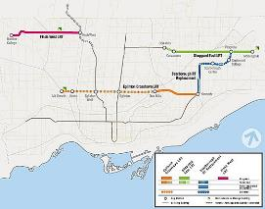
What role does evidence play in policy-making? Case 2 – Scarborough Subway, Toronto

Slide 43
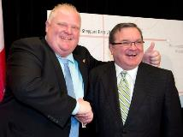
What role does evidence play in policy-making? Case 2 – Scarborough Subway, Toronto
“The people of Scarborough got the short end of the stick from day one,…People in Scarborough deserve a subway. We have to start somewhere, and this is where we’re going to start. I’m a true believer in this, and I’ll fight non-stop for it, and the people of Scarborough want, deserves, and will get subways.”
Rob Ford, Toronto Mayor
“It has to be about subways now. Anything else is seen as second-rate and if you’re supporting anything else, you’re seen as supporting second-class for Scarborough.”
John Tory, Toronto Mayoral Candidate
“I can tell you it’s a decision where there’s no evidence that I can find that justifies it.”
Ann Golden, Toronto Transit Advisory Committee Chair
“I, for the life of me, cannot understand the decision on the Scarborough subway and maybe I’m missing something. I don’t understand why you’d not spend less to serve more people,”
Naheed Nenshi, Calgary Mayor
$660 from Federal Government
$1.4 billion from Provincial Government

Slide 45
Case 3 – Funding the Big Move: What role does evidence play in policy-making?
The Big Move – Greater Toronto
The Big Move - Funding Strategy
25 year, $50 Billion Regional Transportation Strategy

Slide 46
A Second Look at Funding Options: Form A Blue Ribbon Advisory Panel
“Yes we need to pay for it. And so our government is going to find new revenue tools for infrastructure improvements the GTHA. This conversation does not scare me,”

Slide 47
Disregarding the Evidence?
“our transit plan will not include increases in the gas tax, HST or income taxes on middle income families or individuals,”
“I had said all along that funding has to be fair…I am not going to ask the people in North Bay to pay for transit in the GTA . . . that has never been part of our plan.”
Kathleen Wynne
Premier of Ontario
Notes:
The narrative in this case is that taxes will be raised for residents across the province to pay for transit improvements in Toronto, and that this is unfair.
Put differently, other forms of evidence, namely political evidence, is being developed to suggest that these revenue tools are not the most optimal

Slide 48
Why do decision makers go against the evidence?
Evidence often conflicts, and can be used to tell different stories depending on who is telling them, and what factors are given priority
Evidence may conflict with key interest group positions
Technical evidence is often complex and difficult to communicate to the public through the media
Politicians and interest groups may willfully misrepresent the evidence or stress particular points to further their own political ends
Notes:
We have the capacity to produce more evidence than ever before. And yet time and again on big decisions, the evidence is not what’s necessarily used to make decisions. Other symbolic factors take precedence

Slide 49
Why do decision makers go against the evidence?
Non quantifiable factors
histories of place, symbolic narratives of mega-projects take precedence over what ‘technical’ analysis has been done
Mega-projects become symbolic wedge issues that are very popular with certain segments of the public
Notes:
Non quantifiable factors – histories of place, symbolic narratives of mega-projects take precedence over what technical analysis has been done about the merits and viability of a project
Non Quantifiable factors are marshaled skillfully and strategically by politicians and decision makers to promote their preferred projects
Non-quantifiable factors do not always override technical factors; sometimes used to support evidence being presented
Some jurisdictions are more successful at using technical evidence in decision making than others
Some types of mega-projects lend themselves more to technical analysis than non-quantifiable factors

Slide 50
Conclusions
Simplest perspective is to argue for decisions based purely on technical evidence
set up governance structures and decision making processes that encourage technical evidence over politics
There is a need to improve technical project evaluation processes
In practice, policy making is inherently political, and technical evidence about projects merits in terms of costs, benefits and viability is always weighed alongside non-quantifiable symbolic factors that either emphasize or downplay the importance of a project.
More research identifying the specific non-quantifiable factors that are being used to promote certain technologies
Then test extent to which these objectives are actually being met; in other words, unpack the non-quantifiable factors to see if evidence exists to support the claims being made
Notes:
Traditionally, the field of transport studies has viewed decisions to invest in new infra-
structure as being guided by hyper-rational analysis. However, by peeling back the layers and exposing the ironies and internal contradictions that were embedded in the Metro plan- ning process in Bilbao, a new dimension has been added to the study of urban transpor- tation investment. Specifically, a theoretical framework is infused into the field of transport analysis. When public transport projects are presented as being about more than just moving people, it becomes impossible to detach rational planning procedures from the wider regulatory environment and the role of individual agents.

