Slide 1


Slide 2

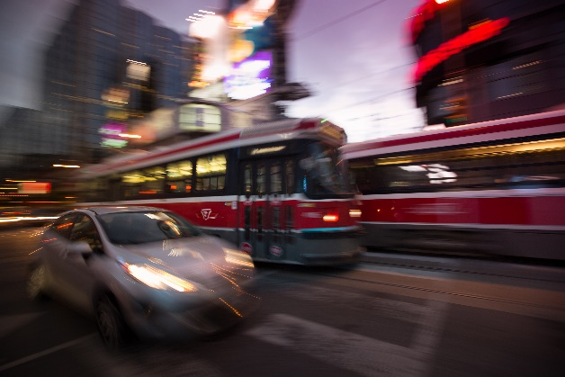
Modelling & Transportation Infrastructure Investment Decision-Making
Presented at:
Public Investment for the Long Term: The Case of Public Transportation
SPPG Policy Institute, Toronto, January 18, 2016
Eric J. Miller, Ph.D.
Professor, Dept. of Civil Engineering
Director, UTTRI
University of Toronto

Slide 3
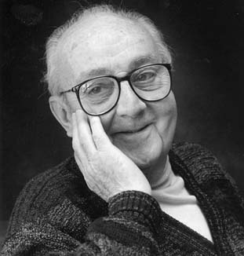
“All models are wrong; some are useful.”
George Box (1919-2013)
How useful have / are / could be travel demand models in transportation infrastructure investment decision-making?

Slide 4
Modelling & Decision-Making (1)
The role of modelling in transportation infrastructure investment & decision-making has been decidedly mixed (to say the least) over the years.
Certainly locally we have too many examples of politicians making decisions on the basis of essentially no evidence – more often than not with unwelcome results.

Slide 5
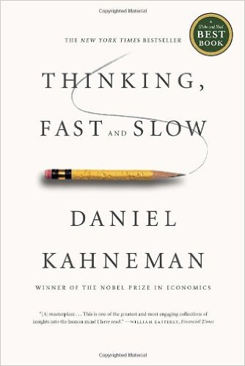
Modelling & Decision-Making (2)
And it’s not just politicians:
  BANANA: Build Absolutely Nothing Anywhere Near Anything
  CAVE: Citizens Against Virtually Everything
  NOPE: Not on Planet Earth.
  Rina Cutler, former Philadelphia Deputy Mayor of Transportation
People clearly often over-estimate the costs & risks of change and underestimate its potential benefits. And vice versa for the status quo.

Slide 6
Modelling & Decision-Making (3)
While recognizing the major influence of politics, etc. on decision-making, without strong data and strong model-based evidence how can it be possible escape the dominance of ideology, bias and just plain ignorance?
The future is clearly a very uncertain place and the notion of estimating future outcomes is perhaps foolish. And yet, should we just make decisions without any attempt to follow the implications of what we think we know about traveller behaviour & needs, transportation system performance and our “best guesses” at likely future conditions?
VKT
Static equilibrium
projection
Trend
Projection
Dynamic, path-dependent
response to policy
initiatives
Historical
Trend
Base
Year
Forecast
Horizon
Time

Slide 7
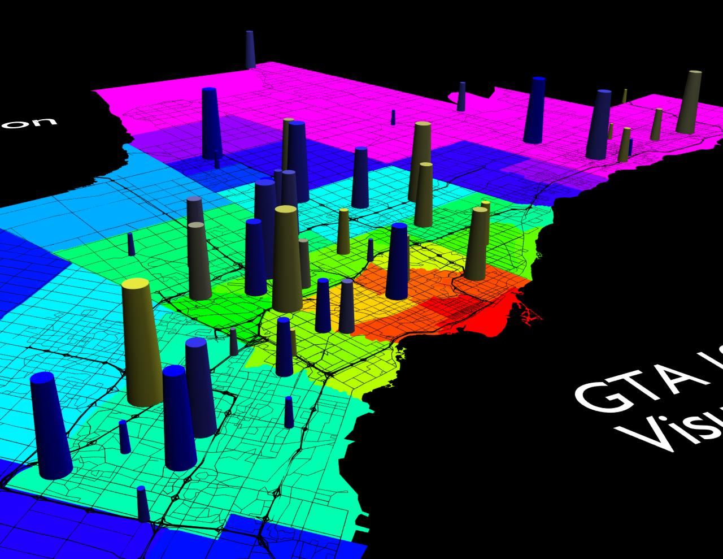
Three Questions:
Are cities and their transportation systems “knowable” / “model-able” in ways that can be useful for policy analysis & decision support?
If yes, do we actually have the tools we need?
If yes, how can these models be most effectively used in policy analysis & decision support?
ILUTE Model Output

Slide 8
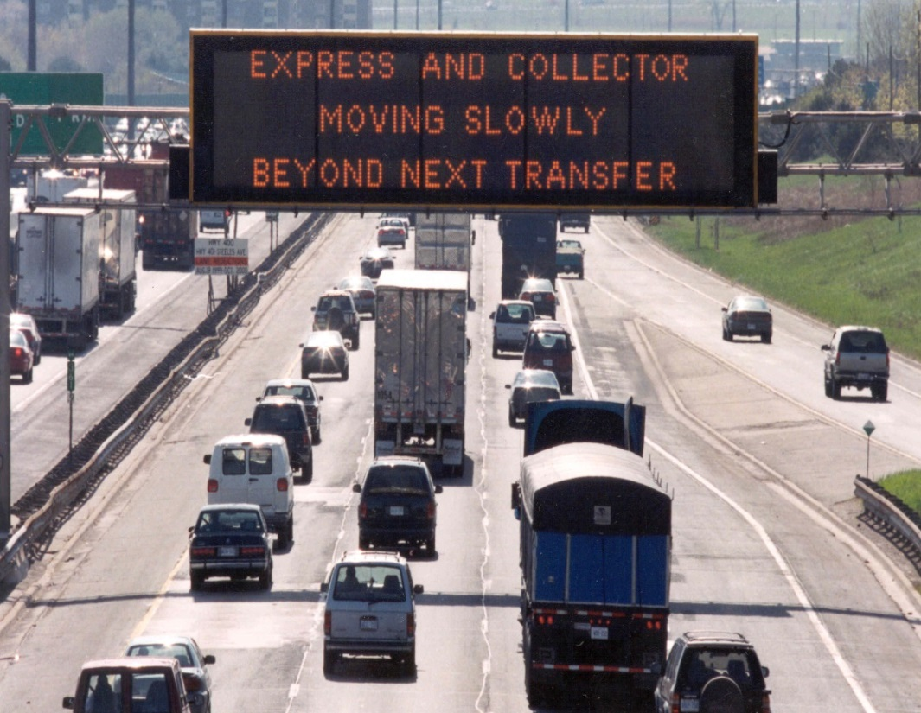

Clearly cities and their infrastructure systems are exceedingly complex: they are systems of systems.
Demographics
Land Use
Economy
Transportation
+
-
Accessibility
Mobility
Productivity
Congestion
Pollution/GHG
Accidents
Loss of Land
+
-
QUALITY OF LIFE

Slide 9
They are also social, economic, cultural and political systems, not just technological in nature.
INPUTS
URBAN ACTIVITY SYSTEM
TRANSPORTATION SYSTEM
Land
Development
Transportation
Network
Demographics
Location Choice
Automobile
Ownership
Regional
Economics
Government
Policies
Activity
Schedules
Travel
Demand
Activity Patterns
Network Flows

Slide 10
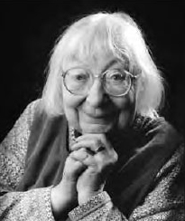

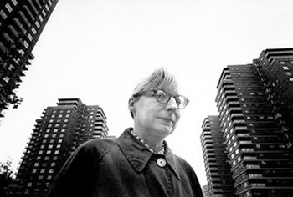
Cities & Complexity: Jane Jacobs
Jane Jacobs in Death & Life of Great American Cities (1961) famously described “the type of problem a city is” as being “a problem in organized complexity”.
This was particularly prescient in that systems theory was in its infancy and complexity theory did not yet really exist.

Slide 11
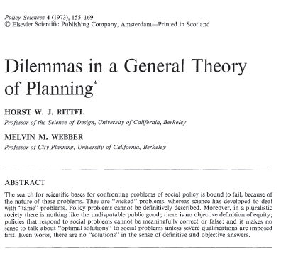
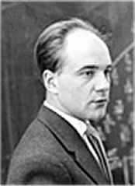
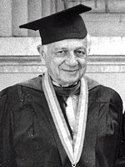
Rittel & Webber: Wicked Problems
A decade-plus after Jacobs, Rittel & Webber (1973) described planning problems as “wicked”, as opposed to the “tame” problems that the physical sciences are designed to address:
  Goals are difficult (impossible) to agree upon
  “Optimization” is impossible
  Problem definition itself is problematic
  “Problems” are never “solved”, we (at best) iteratively “re-solve” them over & over

Slide 12

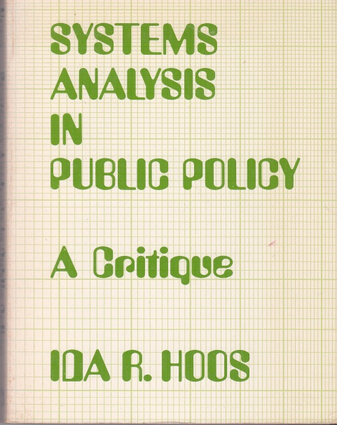
Wicked Problems, cont’d
Rittel & Webber represent typical of reaction against “systems analysis” as it was practiced in the 1960’s during the first generation of high-speed computing and an associated belief that operations research and systems theory could “solve” major policies and even win wars (David Halberstam, The Best and the Brightest, 1972).
Generally, reality fell far short of these claims (I.R. Hoos, Systems Analysis in Public Policy: A Critique, University of California Press, 1972).

Slide 13
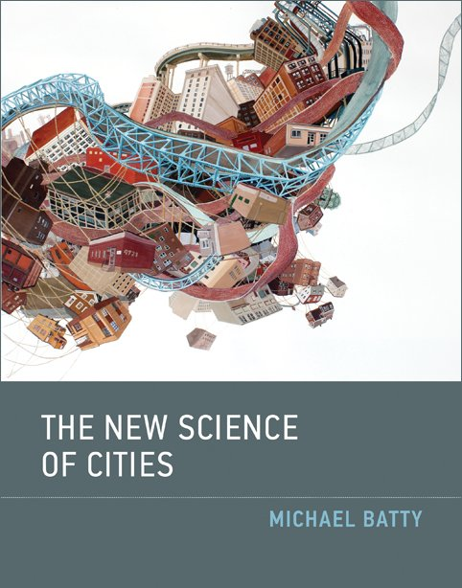
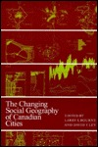


40 Years Later …
Cities remain wicked problems in organized complexity.
But does that mean that they cannot be systematically studied & understood?
“Optimal” “solutions” may be difficult or impossible to achieve but can we not bring analysis-based evidence to bear on decision-making?

Slide 14
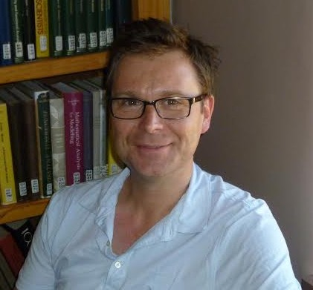
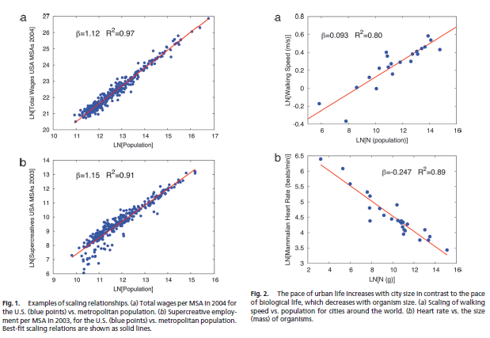
Modelling Cities (1)
Bettencourt (2013):
“There is no longer much of an excuse to ignore many of the measurable properties of cities. Cities across the globe and through time are now knowable like never before, across many of their dimensions: social, economic, infrastructural and spatial.”

Slide 15
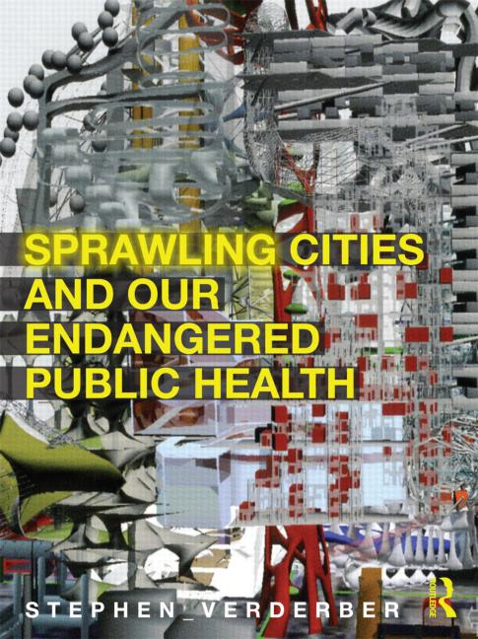
Modelling Cities (2)
Our theory, data, models & computing power have grown tremendously.
If we avoid the hubris of the 1960’s (that everything is quantifiable; that everything is optimizable; that everything is under our control) can we not utilize the methods, data and understanding we have developed since then to address significant urban issues?
And what is the alternative if we don’t?

Slide 16
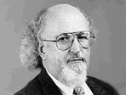
Travel Demand Modelling
Key System Elements
T – transport system
A – activity system
F – flows & transport
system performance
System Interactions/Feedbacks
I Market demand-supply
interactions determine
flows & system performance
II System performance
(accessibility) influences
activity system markets
III Gov’t, public & private
service providers respond
system demand & performance
T
A
I
Standardized approaches for modelling travel demand have been in use since the dawn of digital computing in the 1950’s.
While often useful, these methods have been deeply criticized for decades and certainly have often been misused & abused.
III
II
F
Source: Manheim, M.L. (1978) Fundamentals of Transportation Systems Analysis Volume 1: Basic Concepts, MIT Press
Population & Employment Forecasts
Trip Generation
Trip Distribution
Mode Split
Transportation
Network & Service
Attributes
Trip Assignment
Source: Meyer, M.D. & E.J. Miller (2001) Urban Transportation Planning, New York: McGraw-Hill
Link & O-D Flows,
Times, Costs, Etc.

Slide 17
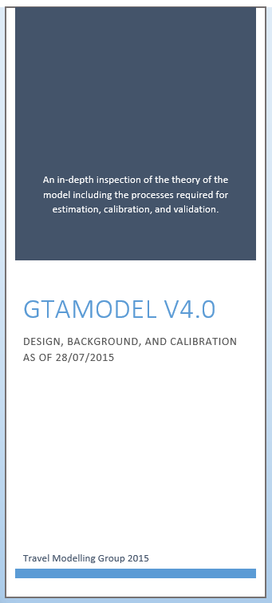
Emerging Models (1)
Fortunately we are in the early days of significantly improved travel demand models that exploit vastly enhanced computing capabilities, data, theory & empirical experience.
As I speak we are using an agent-based microsimulation model that simulates “a day in the life” of every person and household in the GTHA to evaluate transit investment options for the City of Toronto.

Slide 18




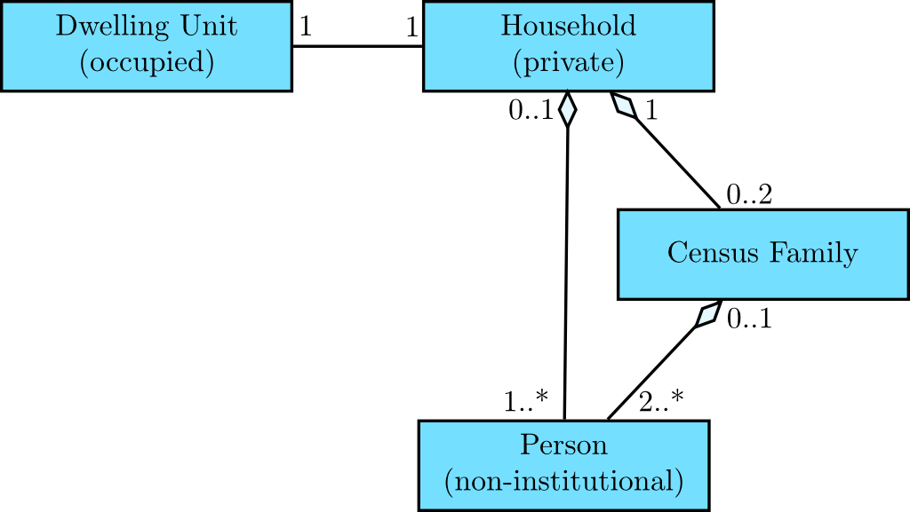
Emerging Methods (2)
These persons/households are synthesized (i.e., not actual real people) but they are (hopefully) representative of a future year population in the region. I.e., we are creating a virtual GTHA that “looks like” the real thing but is, obviously (and inherently) a simplified, abstracted model of the real thing. But it allows us to explore a wide variety of “what if” questions and to generate a lot of detailed information that is hopefully useful in:
  Better understanding travel behaviour.
  Better understanding the impacts of proposed policy (or policies) on travel behaviour and system performance.
  Much more in-depth evaluation of benefits & costs, strengths & weaknesses, winners & losers.

Slide 19
Agent-Based Modelling (ABM)
An intelligent object is an agent. (“an object with attitude” – Paul Waddell). Agents:
perceive the world
around them
make autonomous
decisions
act into the world
ABM provide a an efficient, highly extensible framework for modelling complex human socio-economic activity.
Schedule
Agenda
Vehicle
Household
Dwelling Unit
Zone
Building
Person 1
Person 2
Worker
Job
Firm
Agenda
Schedule
Agenda
Schedule
Agenda

Slide 20
E.g., Daily Tour-Based Trip-Making
time of day
time of day
shop
y
y
travel between
activity locations
by transit
travel between
activity locations
by auto
shop
work
work
home
home
x
x
Base Case 1: Shopping episode on the way home from work. Auto used for the daily activity pattern.
A transit improvement causes the person to shift to transit for the journey to/from work. In order to still go shopping, a new home-based auto-drive trip chain is generated. Auto usage & emissions will be under-estimated by a trip-based model.

Slide 21
Household-Person Models
Household
Allocation
of resources,
assignment of
tasks
Both households & persons must be simultaneously modelled to “properly” deal with many system components. Household level decisions/processes include:
  housing location/type choice
  automobile ownership
  demographics/household
  structure/lifecycle stage
  activity/travel scheduling
Households:
  share resources among household
  members
  constrain member behavior
  condition member decision-making
  generate activities
Requests for resources,
availability for tasks
Person 1
Person 2
Pers1
Pers 2
Car 1
Time
Request for
car
Allocation of
the car to a
given person

Slide 22
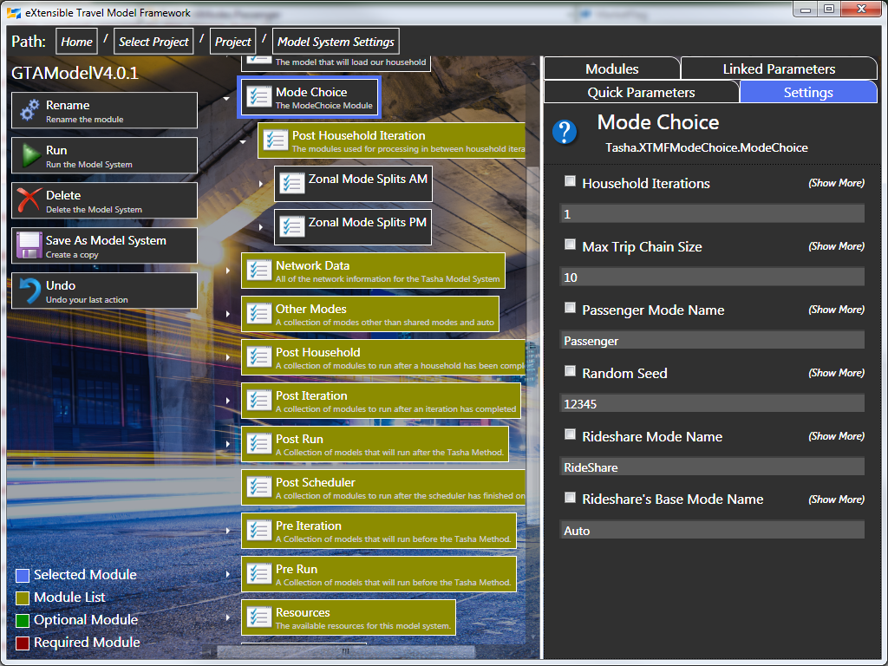
TASHA: Travel/Activity Scheduler for Household Agents
TASHA is the ABM that UofT has built for the GTHA.
Originally developed using 1996 travel survey data for the GTHA.
The activity scheduler was validated against 2001 survey data.
Has been experimentally applied to Montreal, London & Changzhou, China.
Has been completely re-estimated/calibrated using 2011 TTS data for operational deployment by the City of Toronto.

Slide 23
TASHA generates the number of activity episodes from a set of “projects” that a person (or household) might engage in during a typical weekday. It also generates the desired start time and duration of each episode.
It then builds each person’s daily schedule, adjusting start times and durations to ensure feasibility.
Travel episodes are inserted as part of the scheduling process.
Activity Episode Frequency, Start Time and Duration Generation
(a) Draw activity
frequency from
marginal PDF
(b) Draw activity start
time from feasible
region in joint PDF
(c) Draw activity
Duration from
feasible region in
joint PDF
Joint
PDF
Joint
PDF
Activity
Frequency
Start
Time
PDF
Start
Time
Duration
Activity
Frequency
Feasible
Start Times
Feasible
Durations
Scheduling Activity Episodes into a Daily Schedule
Work Project
Work
School Project
Other Project
Other
Shopping Project
Shop 1
Shop 2
:
:
Person
Schedule
At – Home
At-home
Work
Shop 1
Other
Other
At-home
Shop 2
At-home
= “Gap” in Project Agenda
= Activity Episode
= Travel Episode

Slide 24
Tour-Based Mode Choice
Chain c:
1. Home-Work
2. Work-Lunch
3. Lunch-Meeting
4. Meeting-Work
5. Work-Home
mN = mode chosen for trip N
Drive Option for Chain c
Non-drive option for Chain c
m1 = drive
m5
m4
Sub-Chain s:
2. Work-Lunch
3. Lunch-Meeting
4. Meeting-Work
m3
m2
m1
TASHA’s tour-based mode choice model:
Handles arbitrarily complex tours and sub-tours.
without needing to pre-specify the tours
Dynamically determine feasible combinations
of modes available to use on tours. Modes can
be added without changing the model structure.
Cars automatically are used on all trips of a
drive tour.
Drive for
Sub-chain s
Non-drive for
Sub-chain s
m2 = drive
m3 = drive
m4 = drive
m4
m3
m2
m5 = drive

Slide 25
Vehicle Allocation & Ridesharing
Since we are modelling each person within a specific household context, we can explicitly model within-household vehicle allocation and complex ridesharing behaviour.

Slide 26
How Should Models Not Be Used?
Post-facto justification of political decisions.
Barrier to debate & experimentation.
Hard-wiring “desired” decisions/outcomes into the analysis.
Failure to exploit the richness of information generated by the model.
Or, just as bad – models are ignored completely.

Slide 27
How Should Models Be Used? (1)
Policy analysis vs. forecasting.
  Too often we focus on modelling as a forecasting exercise to generate “the number”.
  Models are far better at policy analysis, in which the relative benefits & dis-benefits of alternatives are compared.

Slide 28
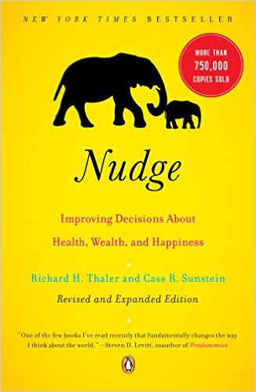
How Should Models be Used? (2)
Models should be used:
  As a laboratory within which we can experiment with alternative system designs & policies.
  To explore alternative paths into the future and their likely consequences.
  To learn & educate.
  To broaden the debate.
  To understand the nature & importance of uncertainty.
  Be “another voice at the table”.

Slide 29

How Should Models Be Used? (3)
ENVIRONMENT
We are potentially entering an era in which advanced models can provide a much richer, flexible and powerful platform for policy analysis & decision support.
Whether we exploit this capability depends on whether planners, politicians & the public actually want:
  Better information.
  Informed debate.
  Flexibility in desired outcomes.
ECONOMY
SOCIETY
S
S
S
U
U
U
S
S
S
T
T
T
A
A
A
I
I
I
N
N
N
A
A
A
B
B
B
L
L
L
E
E
E
U
U
U
R
R
R
B
B
B
A
A
A
N
N
N
T
T
T
R
R
R
A
A
A
N
N
N
S
S
S
P
P
P
O
O
O
R
R
R
T
T
T
A
A
A
T
T
T
I
I
I
O
O
O
N
N
N
NEIGHBOUR
INFRA
-
GOVERNANCE
FINANCING
-
STRUCTURE
HOODS
“The Four Pillars of Sustainable Urban Transportation”, Kennedy, et. al (2005)

Slide 30
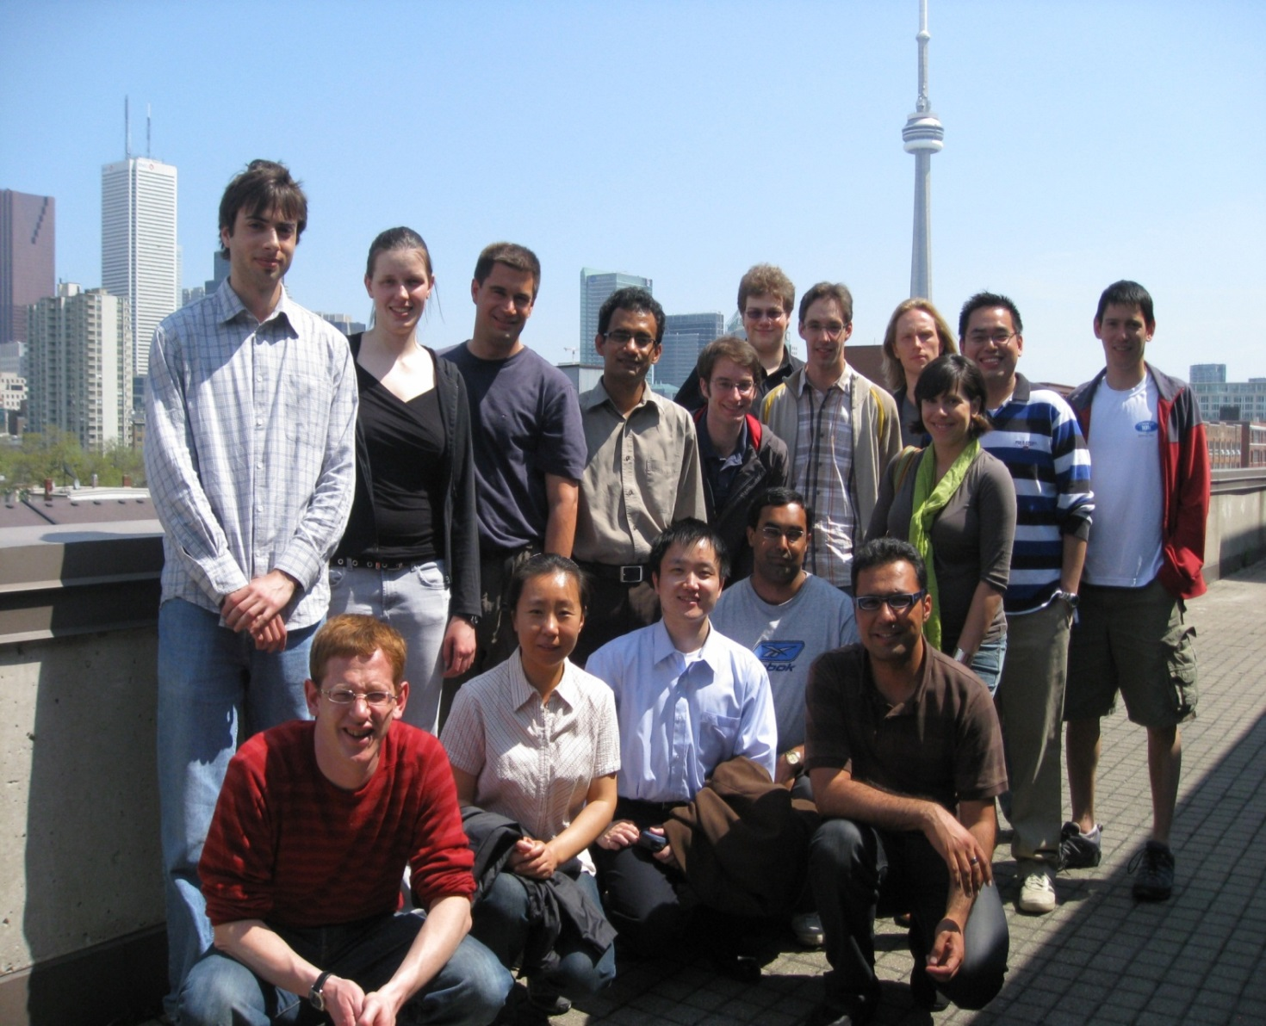
Acknowledgements to the UofT modelling team (past & present):
Matt Austin
Ahad Bekaei
Juan Antonio Carrasco
Leo Chen
Franco Chingcuanco
Len Eberhard
Ilan Elgar
Bilal Farooq
Yiling Deng
Leila Dianet
Sean Doherty
Jared Duivestein
Wenli Gao
Martin Giroux-Cook
Kathryn Grond
Ahsan Habib
Khandker Habib
Torsten Hahmann
Murtaza Haider
Michael Hain
Ayad Hammadi
Jiang Hao
Tony Harapin
Chris Harding
Adam Harmon
He He
Marianne Hatzopoulou
Brian Hollingworth
Nik Krameric
David King
Peter Kucirek
Marek Litwin
Wenzhu Liu
Greg Lue
Kouros Mohammadian
David McElroy
Monika Nasterska
Trajce Nokolov
Gurbani Paintal
Winnie Poon
David Pritchard
Anna Pushkar
Matt Roorda
Adam Rosenfield
Paul Salvini
Bruno Santos
Fernanda Soares
James Vaughan
David Wang
Joshua Wang
Marcus Williams
Yunfei Zhang
THANK YOU! QUESTIONS?

Slide 32
Achieving efficient public decisions in the transport sector
Jonas Eliasson
Professor Transport Systems Analysis, KTH
Department for Transport Science & Centre for Transport Studies

Slide 33
The benefits of formal cost-benefit analysis
What does experience in metropolitan areas internationally tell us about the strengths and weaknesses of cost‐benefit analysis or other decision rules in assessing the short‐ and long‐term factors to be considered in decision‐making about urban transportation?

Slide 34
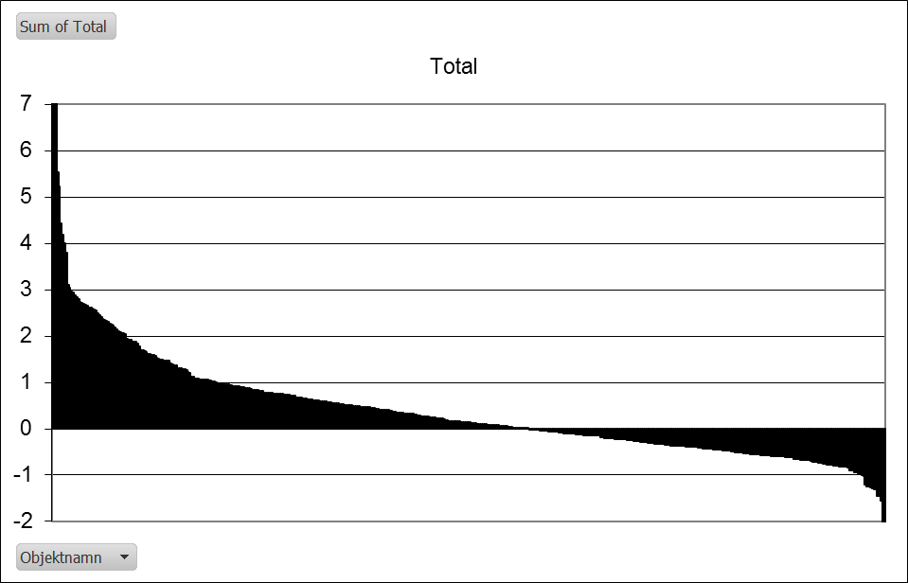
Benefit/cost ratios of 500 investment candidates
Top 150
The ”good” are much better than the ”bad” –
despite being shortlisted by professionals!
Notes:
CBA has many weaknesses – many uncertainties
Valuations of effects
Scenario assumptions

Slide 35
The ranking is not very sensitive to assumptions
 | Changes in Top 150
Double freight benefits | 14
Double safety benefits | 22
Double emission benefits | 5
Double person travel benefits | 11
Differentiated VoT’s | 5
Double oil price | 2
No plugin hybrids | 1
Trend break in car ownership | 2
Strong carbon policy package | 3

Slide 36
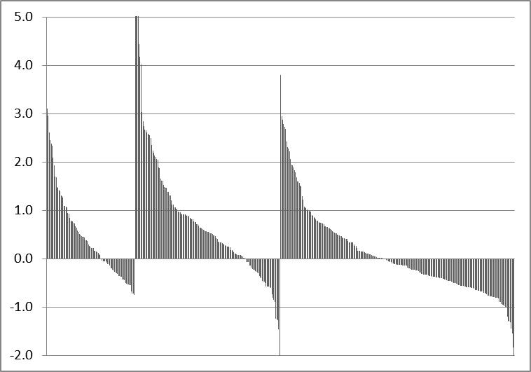
… but cost/benefit efficiency has limited effect
Government
Transport
Administration
Left outside
Notes:
Kanske vi vill ha denna???

Slide 37
Implementing efficient but unpopular policies
What do we know about how the framing and communication of issues affects public attitudes toward various urban transportation options?
Is there a bias toward the status quo?
How can public trust be built, in a context of uncertainty about the projected costs and benefits of urban transportation options?

Slide 38
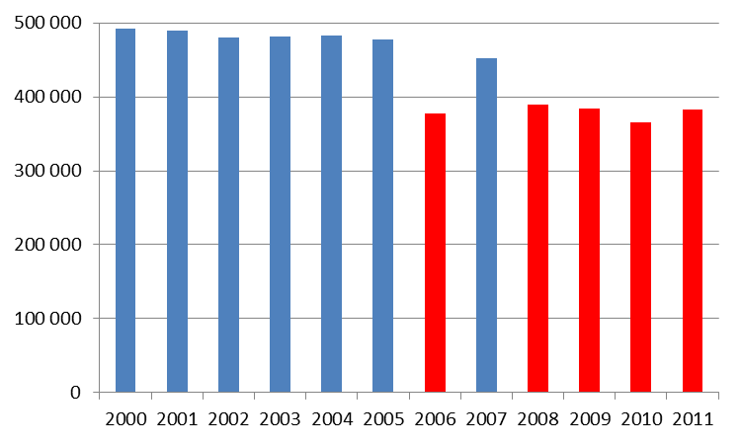
Congestion pricing: It works.
Stable decrease ≈20% across cordon
Notes:
Yes it works. These are figures from Stockholm

Slide 39
What 20% less traffic does to congestion

Slide 40
Difficult to predict or remember behaviour
According to surveys before, traffic would decrese ~5%
According to surveys after, traffic had decreased ~5%
The real figure was 30%
~30% switched from negative to positive during the first year
A year later, half of those claimed that they had had the same opinion all along

Slide 41
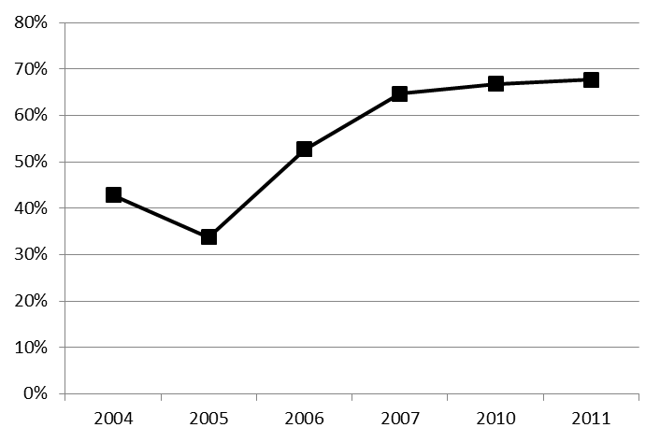
The U-curve of support
Decision
Referendum
Support
Charges introduced
Govt. decision
Notes:
That it worked was perhaps no surprise
The big surprise was the swing in public support.
Remember that CC makes the generalised cost of driving go UP for most people. What caused this swing?
Typical pattern for CC and other policies

Slide 42
So why is congestion pricing so uncommon?
Many win a little, a few lose a lot
Distribution of political power, costs, benefits
Strong public emotions about congestion – but congestion pricing not perceived as solution
Few have strong emotions for ”efficiency”; hence little political upside

Slide 43
Determinants of support for congestion pricing
Self-interest: Personal costs and benefits
Public welfare, especially enviromental effects
Trust in government
Attitude to pricing as a ”fair” allocation instrument

Slide 44
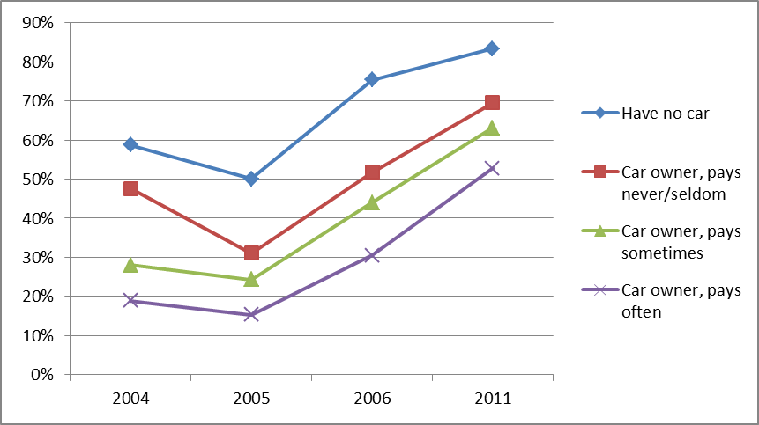
Support for CC split by how much people pay
No car
Have car, never pay
Pay sometimes
Pay often

Slide 45
Drivers of attitude change
It’s better than you thought
It’s not as bad as you thought
Reframing – viewing it as something else
Status quo bias

Slide 46
Questions – answers
What do we know about how the framing and communication of issues affects public attitudes toward various urban transportation options?
Rationality is not enough to get the political ball rolling: positive emotions necessary to make people care
Build alliances: experts + emotions + solving political risks
Is there a bias toward the status quo?
Yes – a lot
How can public trust be built, in a context of uncertainty about the projected costs and benefits of urban transportation options?
Be honest about uncertainties. Blame the experts.
Use trials. Be prepared to change your mind.
Get an institutional setting to survive the valley of political death

Slide 48
Attitude formation (long run)
New attitudes formed by associating to attitudes to ”similar” issues
What is ”similar” depends on framing
New attitudes are less stable – can be re-associated
… especially if re-framed
Politics often a battle of framing
    which existing attitudes and values should a new issue associate to
    Gaining political ground often requires re-framing of issues

Slide 49
Framing congestion charges in Stockholm:
A story in 4 acts
Act 1 (1970-1995):
”Congestion charges gives efficient resource allocation”
Few have strong attitude to ”efficient resource allocation”
Little emotion => little political upside
Noone cares except some transport economists
Eliasson, J. (2014) The role of attitude structures, direct experience and framing for successful congestion pricing. Transportation Research A 67, 81-95.

Slide 50
Act 2 (1995-2002):
”Congestion charges is an environmental measure”
Strong emotions => potentially large political upside
CC looks similar to other such measures => easy to associate to existing environmental attitudes
Enters agenda of Green party, environmental NGOs etc.

Slide 51
Act 3 (2002-2007):
The battle for moral high ground
Opponents try to associate to ”tax”, ”harm the poor”, ”unfair” ”restriction of freedom”
    Preferred term: ”congestion tax” or ”road toll”
Proponents try to associate to ”environment”, ”user pays”, to some extent ”anti-rich” and ”anti-car”
    Preferred term: ”environmental charge”
Results in polarization – e.g. alienation of car drivers
    The less affected people are, the less developed are their attitudes, and the more volatile their attitudes are
    Unaffected car owners decreased their support the most

Slide 52
Act 4 (2007-):
Reframing and emotional discharging
After positive referendum, new government keeps CC
... but earmarks revenues to multi-billion bypass motorway tunnel
Reframing from ”anti-car” to ”efficiency” and ”revenue source”
    ”It’s OK to be a car driver, but please drive less in the city in rush hours”
Less emotions
From moral domain back to technical-rational domain
    The latter less emotional => less political interest

