Slide 2
Investing in the Long Term
Alan m. jacobs
Department of political science
University of British Columbia
alan.jacobs@ubc.ca
Notes:
I’m a political scientist. A lot of my research has been on how governments deal with long-term issues.
Especially interested in how and when democratic governments ares willing and able to invest in the long term at short term cost. Pain today for gain tomorrow.
I’m not an expert on transportation policy. But what I hope to do today is to think somewhat conceptually about the politics of investing in the future – to think with you about why this is an especially difficult thing to do politically; to think about conditions that are more favorable to doing it; and to suggest a few hunches about how what we know in general about the politics of the long term might apply to investments in transportation infrastructure.
As I do so, I’ll be drawing some on my own work in this area, but also much more broadly on what social science – including studies of public policy and of cognitive psychology have to tell us.

Slide 3
Governments that invest in the long term
Notes:
So as I say, I study how and when elected governments look beyond the next election to invest in the long term.
When I tell people this, it’s often like I’m telling them I study unicorns.
The most common response is: do they? Do elected officials ever look after the long term? Aren’t they always just focused on winning reelection in the short term? Giving voters tax cuts and other goodies in the here and now?
Well, there is certainly a bias toward the short run. But the policy landscape is by no means one of uniform short-termism. What we see instead is variation.
We can take a brief look across that policy landscape to get a very rough sense of that variation.
Take fiscal policy, for instance. Are governments accumulating large debts to pass on to future generations, or imposing sacrifice to pay down those debts?

Slide 4
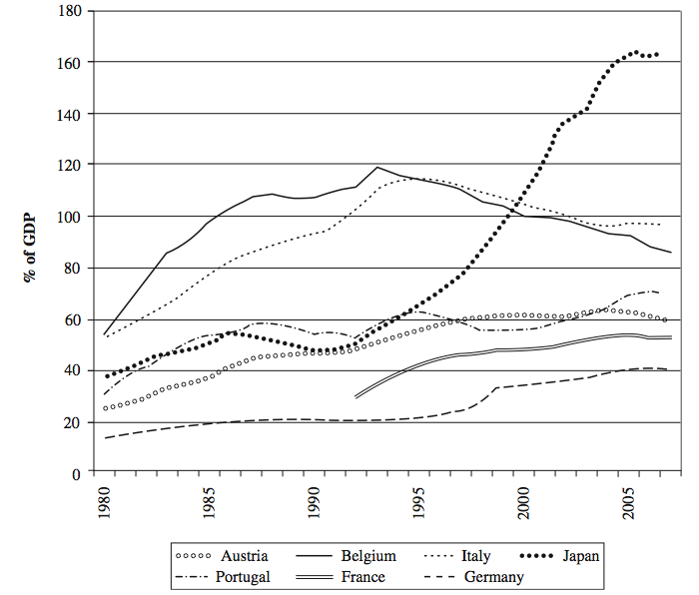
Mortgaging the future: The worst fiscal-performers
Notes:
Well, some of what we see is what many people would expect – mortgaging the future

Slide 5
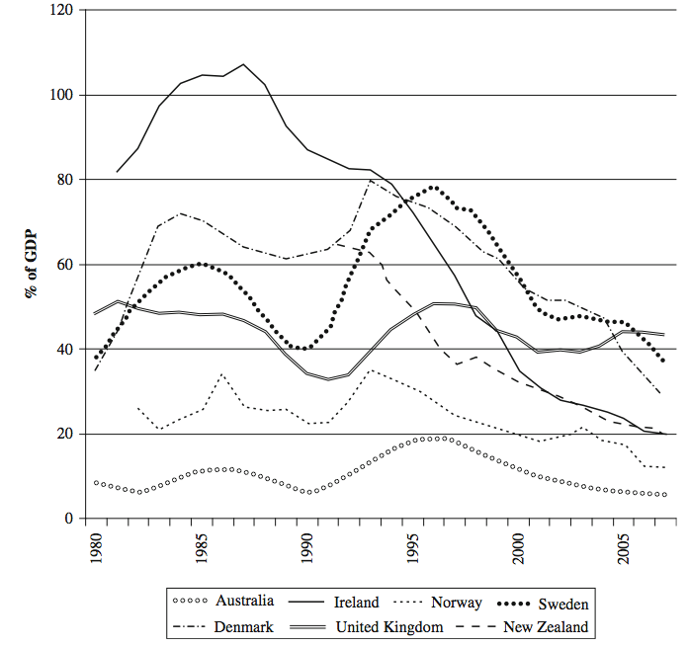
Investing in the long term: The best fiscal-performers
Notes:
But then we also see investments in the long term.
And there’s plenty of variation left over even after we take into account different macroeconomic situations etc. There are real differences in policy choices.

Slide 6
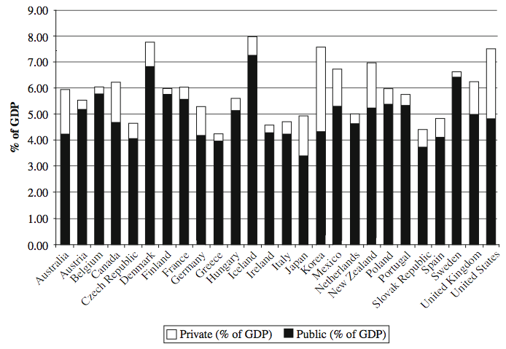
Varying investments in the workforce: Education spending
Notes:
Investments in tomorrow’s workforce and citizenry.
Not just a function of levels of economic development.

Slide 7
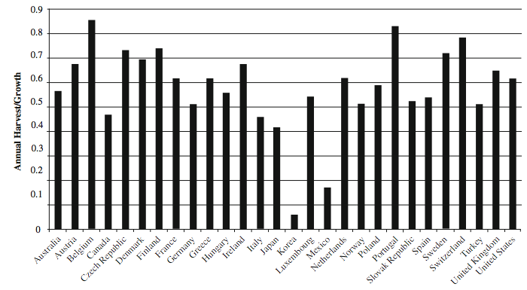
Varying management of natural resources: Timber
Notes:
Managing natural resources – widely varying rates at which forest resources are replenished.

Slide 8
Varying investment in infrastructure
2011 transportation infrastructure investment as % GDP (Source: OECD)
Notes:
And, closer to today’s topic: widely varying investments in transportation infrasteucture,

Slide 9
Varying investment in infrastructure
2013 transportation infrastructure investment as % GDP (Source: OECD)
Notes:
And, closer to today’s topic: widely varying investments in transportation infrastructure. Have limited to the rich Anglo-democracies and older members of the EU, Japan, and Korea.

Slide 10
An intertemporal policy tradeoff
Early childhood education
Regulating fisheries
Anti-smoking campaigns
Carbon taxes
Disaster-preparedness
Investment
Status quo
Notes:
Let’s step back from the details and think about an ideal-typical policy that makes an investment in the future.
It’s a tradeoff over time.
Policy analyses indicate lots of policy fields where societies can reap large returns in the future with up-front investments.

Slide 11
Impatience?
Notes:
So why is this hard?
Most of you know about the Walter Mischel’s famous marshmallow experiments of the 1960s and 1970s – to see why some children can defer gratification while others can’t. Would they eat one marshmallow right away rather than wait for 2?
We might think that the main reason why societies find it difficult to invest in the future is an inability to defer gratification – pure impatience or time preferences. We just want our marshmallow now.
This may play some role, How patient we are may play an important role in individual life choices and outcomes. But I’m going to suggest that this isn’t really the key thing when it comes to the politics of the long term.

Slide 12
Three challenges of investing in the long term
The poverty of information about the long term
Political uncertainty of the long run
Opposition from mobilized cost-bearers

Slide 13
Challenge 1: The poverty of information about the long run
Notes:
So let’s think about this first challenge – one of information. Here’s the basic idea. It’s….

Slide 14
The clarity of the present vs....

Slide 15
...the fog of the future

Slide 16
Challenge 1: The poverty of information about the long run
Information about the long run is poorer than information about the short run:
The future is less knowable than the present
Future conditions (unemployment rates, traffic levels, etc)
Long-run policy benefits

Slide 17
Growing uncertainty over time: UN global population projections
Notes:
This is true even for experts.
Much more so for voters.
Basic idea underlying models of economic voting.

Slide 18
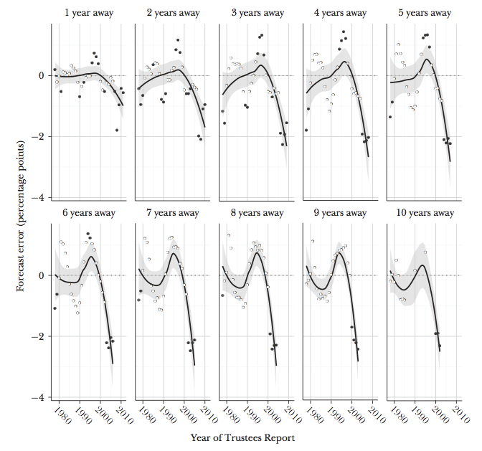
Errors in U.S. Social Security forecasting (Kashin et al 2015)
Notes:
One example to illustrate. A group of scholars looked back at how well the Social Security actuaries did in forecasting the future financial state of the program.
The dots, and the line smoothing across them, shows the forecasting errors made in each year’s actuarial report.
1 away, the errors are small. 2 years away, they get bigger. Beyond about 3 or 4 years, they are seriously overstating

Slide 19
Challenge 1: The poverty of information about the long run
Information about the long run is poorer than information about the short run:
The future is less knowable than the present
Future conditions (unemployment rates, traffic levels, etc)
Long-run policy benefits
The future is less salient than the present
The vividness of the “here and now” vs.
The abstractness of a projection
Notes:
Just like

Slide 20
An intertemporal policy tradeoff
The election
?
Policy A
Status quo
Policy B
Investment
Notes:
So this creates a political problem for elected officials. Maybe investment will be much better over the long run. But voters

Slide 21
Challenge 2: Political uncertainty
Long-term investments are elite-citizen bargains in which citizens pay first
Democratic politics itself makes those bargains risky:
Today’s politicians may “take the money and run”
Taxes collected now for one purpose may be spent on something else later
Today’s politicians may not be in office tomorrow
And tomorrow’s politicians may not keep promises made by today’s
Notes:
Affects both ordinary citizens and politicians themselves.
I want to focus on ordinary citizens

Slide 22
We don’t wait for uncertain marshmallows (Kidd et al 2012)
Notes:
In fact, this taps into a fundamental feature of human pyschology. Later studies of the marshmallow dynamic showed that kids who were given reason to trust the reliability of the adult promising them the second marshmallow were much more willing to wait for it.

Slide 23
Failure to invest: Metro Vancouver
Notes:
And it appears that political uncertainty – or trust – played a major role in Metro Vancouver voters’ recent rejection of a big investment in transit infrastructure.

Slide 24
A matter of trust

Slide 25
A matter of trust
Notes:
Reading the comments under news stories is not normally an edifying experience. But setting that aside, here are the first three comments under this story in the Surrey Leader.

Slide 26
A matter of trust

Slide 27
A matter of trust

Slide 28
Experimental evidence on uncertainty (Jacobs & Matthews 2012)
Study asked U.S. citizens to evaluate an investment in solvency of Social Security program, with short-run costs
Random assignment to benefits either 5 or 40 years away
→ Discounting effect
Support falls as benefits become more temporally distant (5 vs. 40 years)
But why?
Uncertainty
Notes:
Also some experimental evidence bearing on the point. My collaborator, Scott Matthews, and I told a large group of U.S. subjects about a policy proposal to shore up the Social Security system.
And we randomized randomly assigning them to versions of the choice that differed in the distance in time at which the benefits would be delivered.

Slide 29
Trust in government conditions effects of delay (Jacobs/Matthews, BJPS,s 2012)
Notes:
One piece of the evidence we present on this pint.
Among those with low trust in government, delaying the benefits 40 years reduces support. But among those with high trust in government, no effect.
It’s not that people are fundamentally unwilling to pay now for benefits later. It’s that they often don’t trust that if they do pay now, they’ll actually get the benefits later.
A number of other studies have found that people’s willingness to pay for public goods depends on their trust in govt.

Slide 30
Challenge 3: Opposition from “concentrated” cost-bearers
For some long-term investments, a “concentrated” group bears disproportionate short-run costs
Environmental protection → resource industry
Pension reform → seniors
Infrastructure investment → local communities (e.g., NIMBY interests)

Slide 31
Heathrow expansion
Notes:
Opponents of building a new runway at Heathrow airport.
Or the local shop owners along Cambie Street in Vancouver who suffered when the Canada line was built.

Slide 32
Challenge 3: Opposition from “concentrated” cost-bearers
For some long-term investments, a “concentrated” group bears disproportionate short-run costs
Environmental protection → resource industry
Pension reform → seniors
Infrastructure investment → local communities (e.g., NIMBY interests)
Concentrated groups are often mobilized and organized
→ Equipped to fight to block investment
Notes:
From countless studies of the politics of public policy.

Slide 33
Challenge 3: Opposition from “concentrated” cost-bearers
Two distributional varieties of investment:
Type 1. My pain today/your gain tomorrow
Bad deal for me
→ I fight it – no matter what
Type 2. My pain today/my gain tomorrow
Could be a good deal for me (if I trust I’ll get the gain)
But wait: could there be a better deal for me?
Your pain/my gain?
→ A fight over who should pay
Notes:
And this can play out in a couple of different ways, depenidng on the kind of long-term project.
Type 1 is an investment that is also redistributive:
e.g., the costs are paid by industry, the benefits are enjoyed by everyone.
e.g., the costs are paid by the folks living next to Heathrow, the benefits broadly enjoyed.
Type 2 is more of a straight intertemporal tradeoff:
e.g., workers pay more to make the pension system more solvent
e.g., users of infrastructure pay more to improve that infrastructure.
But there can still be jostling over whether the costs should be distributed differently. Maybe higher-income households should pay more. Maybe it should be axpayers, not users, etc..

Slide 34
Overcoming the challenges to long-term investment
Under what conditions…
…are voters likely to attend to long-term outcomes?
Think cognitively
…are voters likely to trust long-term benefit promises?
Think institutionally
…can governments assuage or overcome potential, organized opposition?
Think about policy design

Slide 35
1. Bringing voter attention to the long term
Think cognitively:
Investments generating early, salient indicators of future benefits
Long-term projects often become visible in short term
Esp. local investment in physical capital
An infrastructure advantage?
Framing strategies
Avoiding losses, not pursuing gains (e.g., Kahneman/Tversky)
Notes:
Lessons from political science and cognitive psychology.
Early indicators:
Framing examples: Social Security reform; Obamacare.

Slide 36
Investment as pursuit of gains
Investment
Status quo

Slide 37
Investment as loss-avoidance
Investment
Status quo
Notes:
A lot of infrastructure investment can probably be very plausibly framed in these terms.

Slide 38
1. Bringing voter attention to the long term
Think cognitively:
Early, salient indicators of future benefits
Long-term projects often become visible in short term
Esp. local investment in physical capital
An infrastructure advantage?
Framing
Avoiding losses, not pursuing gains (e.g., Kahneman/Tversky)
“Focusing events” as early warning signals
Notes:
Studies of agenda-setting.
Focusing events – dramatic events or crises that concentrate attention on a policy problem. A plane crash, a nuclear plant crisis, unusual weather.

Slide 39
Ontarians’ Google searches: “climate change”
That warm fall

Slide 40
2. Generating confidence in long-term benefits
Think institutionally:
Allocation of responsibility
Delegate implementation to more-trusted rather than less-trusted public actors
Experimental evidence in context of transportation infrastructure (Jacobs/Matthews 2016)
e.g., Congress vs. local governments
Notes:
Allocation of responsibility: long-term investments have to be implemented by someone. Someone has to manage the resources and carry out the investment.
WHO THAT WILL BE MAY BE QUITE IMPORTANT.
- We see examples like transit referendum in Metro Vancouver where it looks like the trustworthiness of those responsible had an effect. But that doesn’t tell us that this is something that can be changed. So experimental evidence helps here.
Suggests maybe the Metro Vancouver mayors’ mistake was that they should first have reformed or burnished the image of Translink before asking voters for sacrifice
Rules: Can’t hypothecate everything. But think about ways in which elites can make their promises to citizens credible by tying their own hands.

Slide 41
A good idea…

Slide 42
…but a bit late.
Notes:
The mayors knew this, but were constrained

Slide 43
Trust issue a “red herring”
Notes:
This was probably consequential.

Slide 44
2. Generating confidence in long-term benefits
Think institutionally:
Allocation of responsibility
Delegate implementation to more-trusted rather than less-trusted public actors
Experimental evidence in context of transportation infrastructure (Jacobs/Matthews 2016)
Congress vs. local governments
Rules
Tie politicians’ hands
E.g., hypothecation or trust-fund financing (Jacobs/Matthews 2016)
Notes:
Rules may also have a role to play in shoring up credibility.

Slide 45
3. Overcoming mobilized opposition
Think policy design:
How costs are distributed
Focus the pain on the beneficiaries (e.g., user fees)
The “losers” are also the “winners”
Fairness as reciprocity
Spread the pain (e.g., general taxation)
Reduces cost-salience
Fairness as progressivity
How benefits are distributed
Compensate losers out of expected aggregate gains
Turn “My pain/your gain” into “My pain/my gain”
Notes:
Welfare-state reform is also a project of imposes costs. This literature provides some insights.
- How costs are distributed: really two kinds of strategies that are worth considering

Slide 46
3. Overcoming mobilized opposition
Borrowing to invest
“Golden rule” budgeting: OK to defer costs for endeavors that pay off over the long run
BUT
Problems of classification: what counts as investment?
Doesn’t eliminate all short-run costs

Slide 47
These folks will still be unhappy

Slide 48
3. Overcoming mobilized opposition
Borrowing to invest
“Golden rule” budgeting: OK to defer costs for endeavors that pay off over the long run
BUT
Problems of classification: what counts as investment?
Doesn’t eliminate all short-run costs
Inclusive decision-making processes
Will slow things down but…
….encourages policy designs of shared pain, shared gain

Slide 49
Closing thoughts
The politics are one thing; getting the policy itself right is another…
And also complicated by long-termness
Much hinges on whether the costs are paid upfront or deferred
Fundamental first question: do we borrow to invest?
Notes:
Borrowing esp makes sense of course in a context of economic slack.

Slide 50
Maybe it’s NOT intertemporal policy tradeoff
Investment
Status quo
Notes:
Then it doesn’t necessarily look like this. It may be gains in the short run AND in the long run

Slide 51
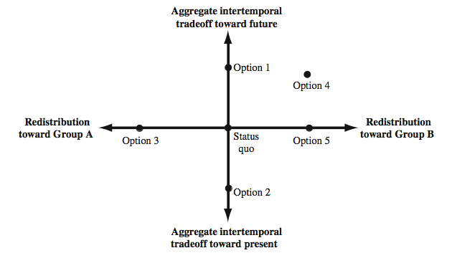
Two dimensions of policy choice

Slide 53
Public Investment for the Long Term
Governing for the Long Term
Michael Smart University of Toronto
January 18, 2016

Slide 54
How should infrastructure be financed?
The “golden rule” of public investment: Borrow to finance most public capital
Current taxes finance interest and depreciation on (steady state) capital
Revenue for infrastructure should be user fees or benefit taxes where possible
In principle, following these rules should minimize political conflicts and economic distortions from financing investment –
leading to the “right” spending decisions.

Slide 55
Why doesn’t this work in practice?
Short-termism for politicians, voters
Political benefits to narrowcasting expenditures in place of public goods
Coordination failure for governments Common pool problems in grants Information failure for voters

Slide 56
Can small reforms help? Insights from economics
I. Accounting rules matter
Accounting rules help politicians and voters understand long-term expenditures, and plan accordingly
Accrual accounting usually makes sense – even where assets are not marketable
book expense when economic costs/benefits really accrue facilitate golden rule finance, and generational accounting
Avoid fiscal and accounting rules that are easy for governments to “unravel”
Avoid fiscal and accounting rules that distort organizational choices when they are (inevitably) unravelled
e.g. Metrolinx and the Eglinton subway – provincial deficit concerns should not drive who owns, operates the asset

Slide 57
Can small reforms help? Insights from economics
II. Governments must be transparent
All projects should be supported by published cost-benefit analysis performed according to generally accepted principles – why is this not done?
Long term government policies can have large implications for generational equity (pensions, deficits, environmental policy, capital)
All such budgets should include explicit generational accounting estimates as a matter of course Understanding the size and direction of generational tramnsfers in our polity might change debate over infrastructure and deferred investment

Slide 58
Can small reforms help? Insights from economics
III. The media must get smarter
For this debate, it’s important to understand:
operating vs. capital expense
annual vs. repeated long term expenditure present value of flows and annuity value of stocks
avoid fiscal illusion, sunk cost fallacy, endowment effects
e.g. Toronto recently implemented a special levy to pay for a new subway in Scarborough, to be phased in over four years
that does not mean the levy is removed after four years!

Slide 59
Can small reforms help? Insights from economics
IV. Avoid fiscal gimmicks
There is a limited role for new “revenue tools” to finance urban infrastructure, but they are not a panacea, and they do not make projects free.
DCs and TIFs?
intergovernmental grants actually make very little sense, unless projects cross jurisdictional boundaries
road pricing for congestion, but not mainly to raise revenue the residential property tax is almost always the most
equitable AND efficient way to finance municipal services

Slide 60
Concluding remarks
This brief survey of challenges in infrastructure finance should not be seen as too bleak: “democracy is the worst form of government, except for all the others”.
An efficient public finance system, based on user fees and benefit taxes, has the potential to reduce conflicts and inefficiencies, and build voter support for infrastructure spending.
A transparent and informed debate about costs and benefits, while not palatable to all, has potential to build confidence in the system and improve decision-making.

